Slide 1
More Drawing Loops
CS 142
David Anderson
Slides by Martin Hock

Slide 2
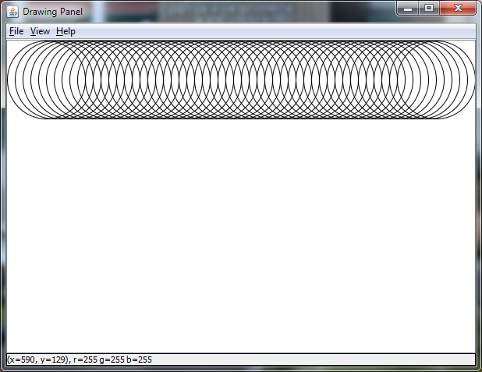
Review: Drawing a line of circles
// Inside main method of DrawingLoops int x = 0; while (x + 100 <= width) { g.drawOval(x, 0, 100, 100); x = x + 10; }

Slide 3
Review: Using a for loop
Initializer: can be any Java statement but usually sets up a variable that will be checked in the check part and modified in the increment
Check: same as a while condition, run at the start of each loop-thru
Increment: run at the end of each loop, usually modifies the variable
for (int x = 0; x + 100 <= width; x = x + 10) { g.drawOval(x, 0, 100, 100); }
for (<initializer>; <check>; <increment>) <statement-or-block>

Slide 4
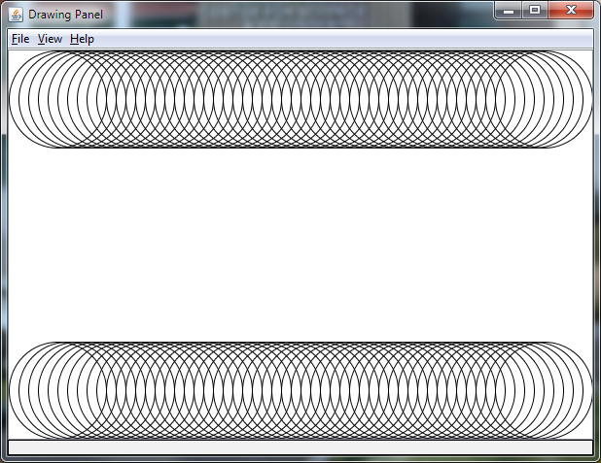
Drawing a horizontal line at the bottom
We can copy and paste the for loop to draw a line at the top in order to draw the same line at the bottom
We only have to make one tiny change to one number!

Slide 5
Solution
for (int x = 0; x + 100 <= width; x = x + 10) { g.drawOval(x, height - 100, 100, 100); }

Slide 6
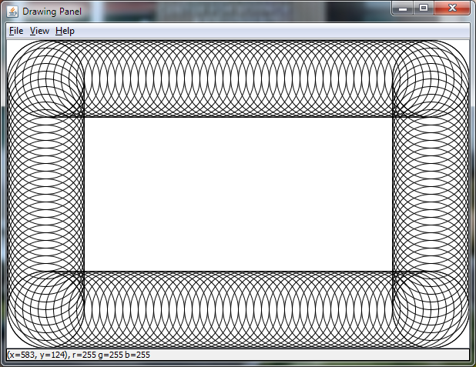
Exercise: drawing vertical lines
Write code to draw vertical lines of circles to make a box!
You could write it as two for loops, or draw circles for both lines in one for loop

Slide 7
Solution
for (int y = 0; y + 100 <= height; y += 10) {
// draw the left oval
g.drawOval(0, y, 100, 100);
// draw the right oval
g.drawOval(width - 100, y, 100, 100);
}

Slide 8
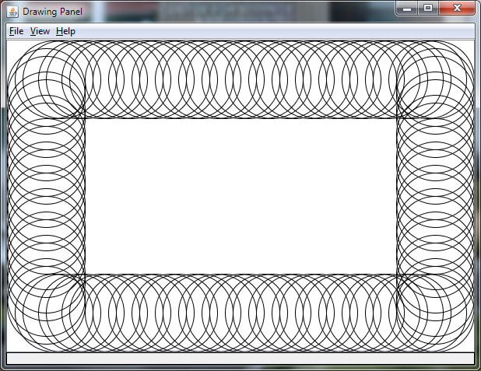
Skipping drawing some circles
What if we’d like to only draw some of the circles?
Let’s draw two circles, skip one, draw two, skip one, etc…

Slide 9
continue statement
Whenever Java encounters continue within a loop, it goes back to the top of the loop immediately
In the case of a for loop, this will execute the increment statement followed by the check
In the case of the while loop, it just executes the check, so this technique wouldn’t have worked as well for the while version – it would have skipped the x = x + 10 at the bottom, so the code would have gotten stuck!
continue;

Slide 10
Using the continue statement to skip circles
We can check to see if the current x or y value is divisible by 3
Use the divisibility code we came up with for primality testing
x or y takes on successive multiples of 10
for (int y = 0; y + 100 <= height; y += 10) {
if (y / 3 * 3 == y) continue; // skip drawing this y
// draw the left oval
g.drawOval(0, y, 100, 100);
// draw the right oval
g.drawOval(width - 100, y, 100, 100);
}

Slide 11
Counterintuitive behavior for if statements
Pay attention to the difference between = and ==
An assignment in an expression takes on the value being assigned
if (x = true) will assign x to true - since it’s true will execute the body!
You don’t ever have to test boolean variables against true and false!
if (x == true) is the same as if (x) (x is true if x is true…)
if (x == false) is the same as if (!x) (!x is the opposite value of x)
You can’t say “if x and y are equal to something” as in English; you must compare each of them individually!
if (x && y == false) will only compare y to false – this statement is really saying “if x is true and y is false”

